Slide 1
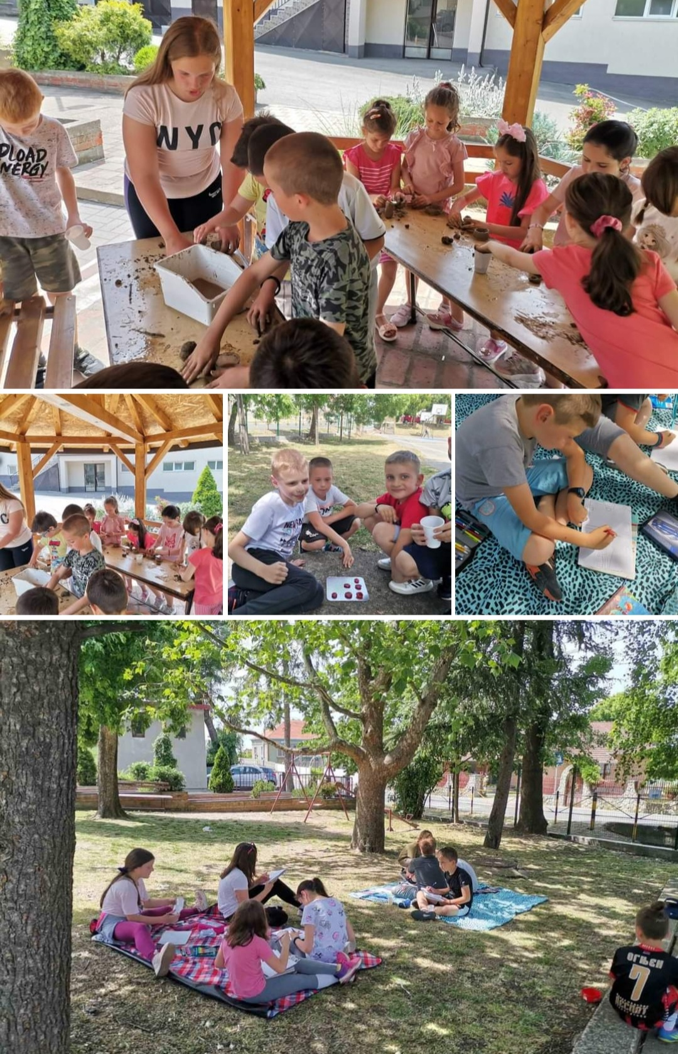
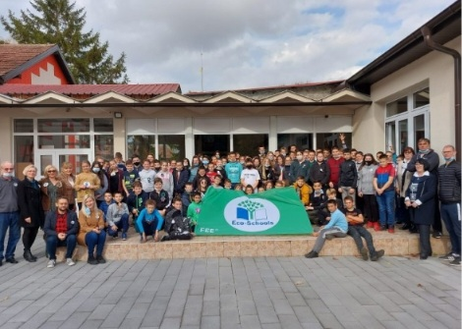
QUALITY EDUCATION AND WELLBEING AT SCHOOL : TOWARDS A CARING SCHOOL
Primary school 'Karađorđe', Velika Plana, Serbia oskaradjordje.edu.rs

Slide 2
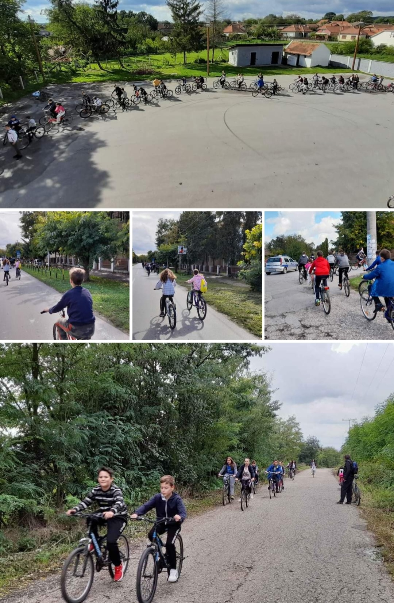
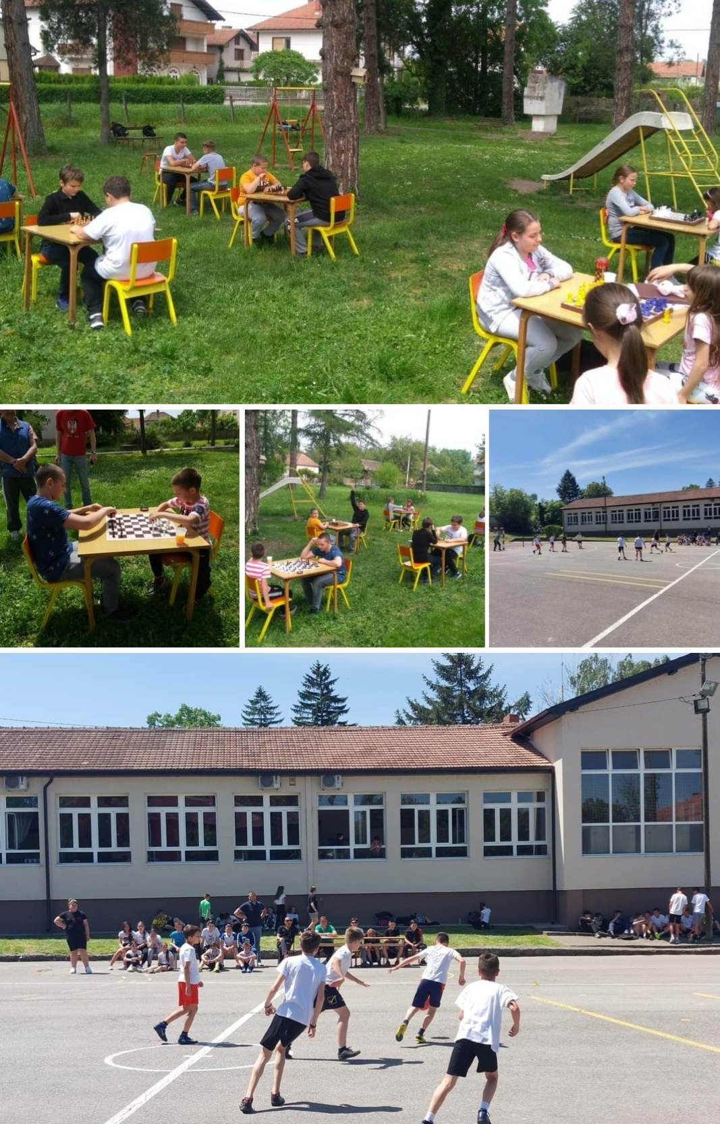
Be active - Health - Connect - Give

Slide 3
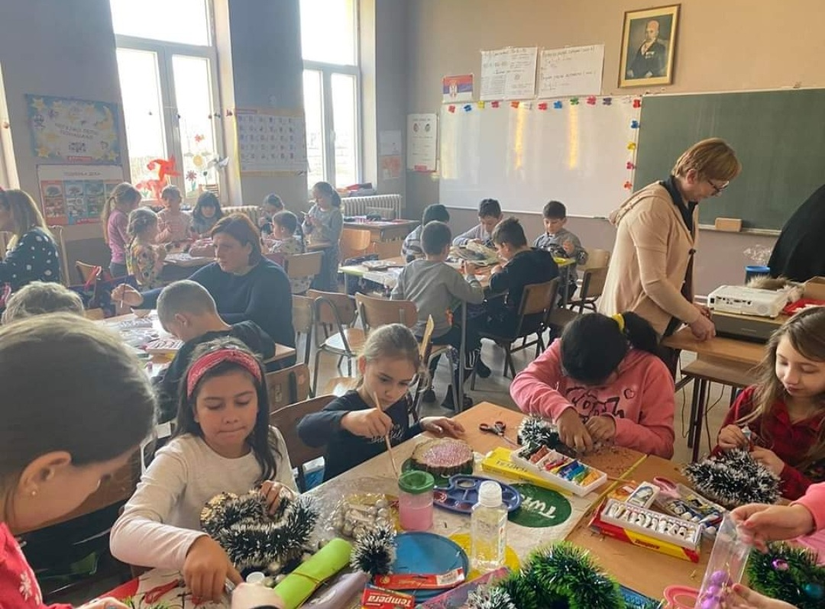
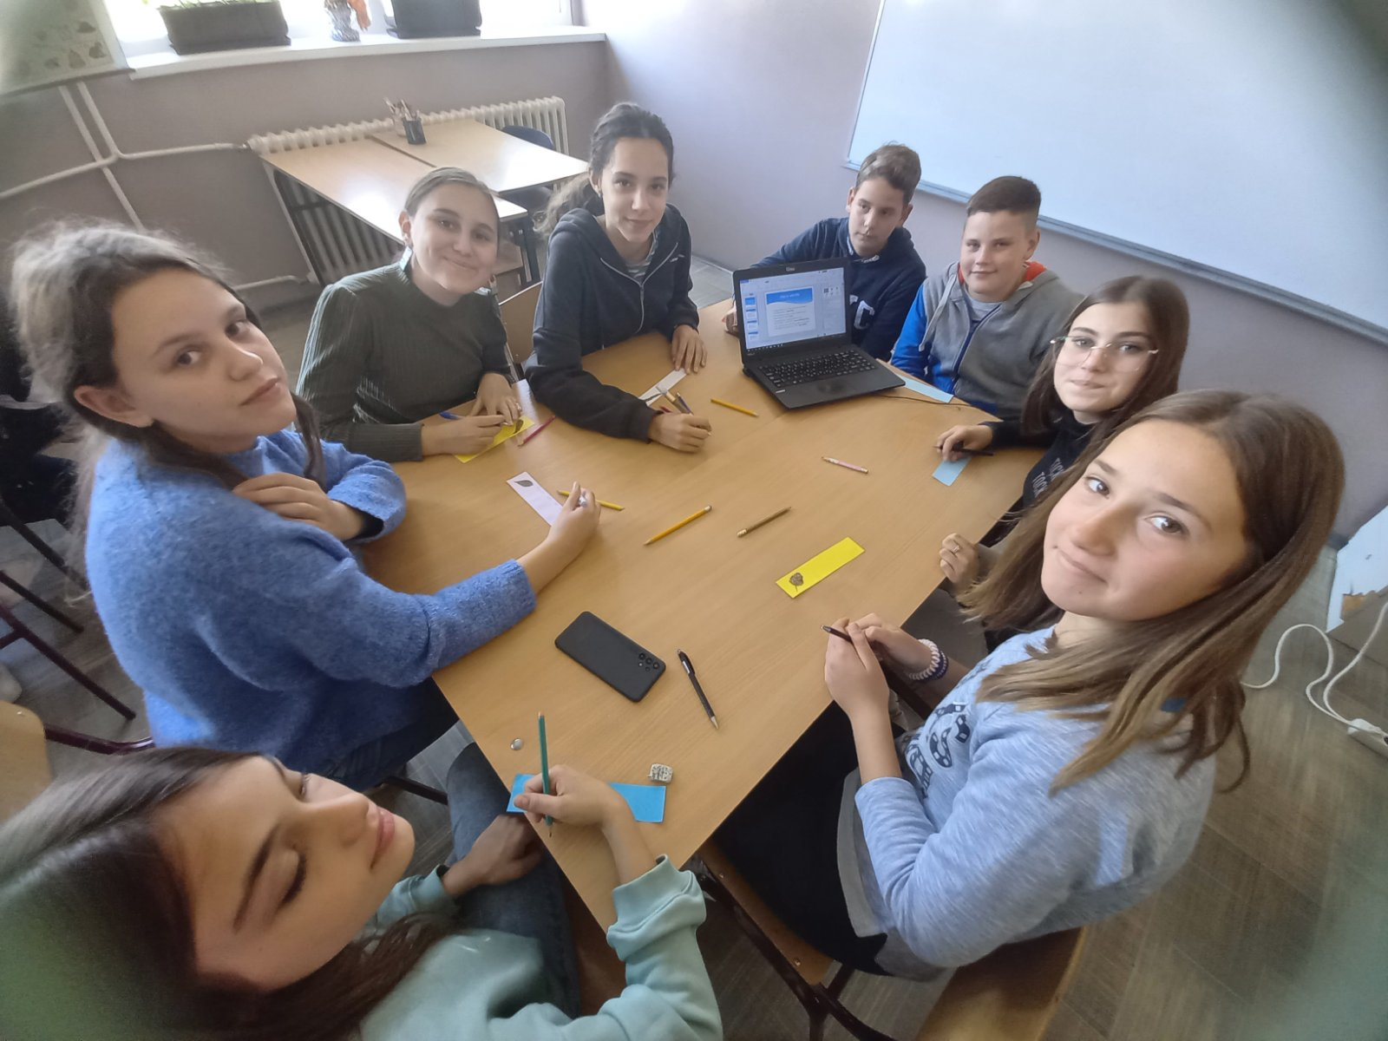
Take notice - Success - Inclusion

Slide 4
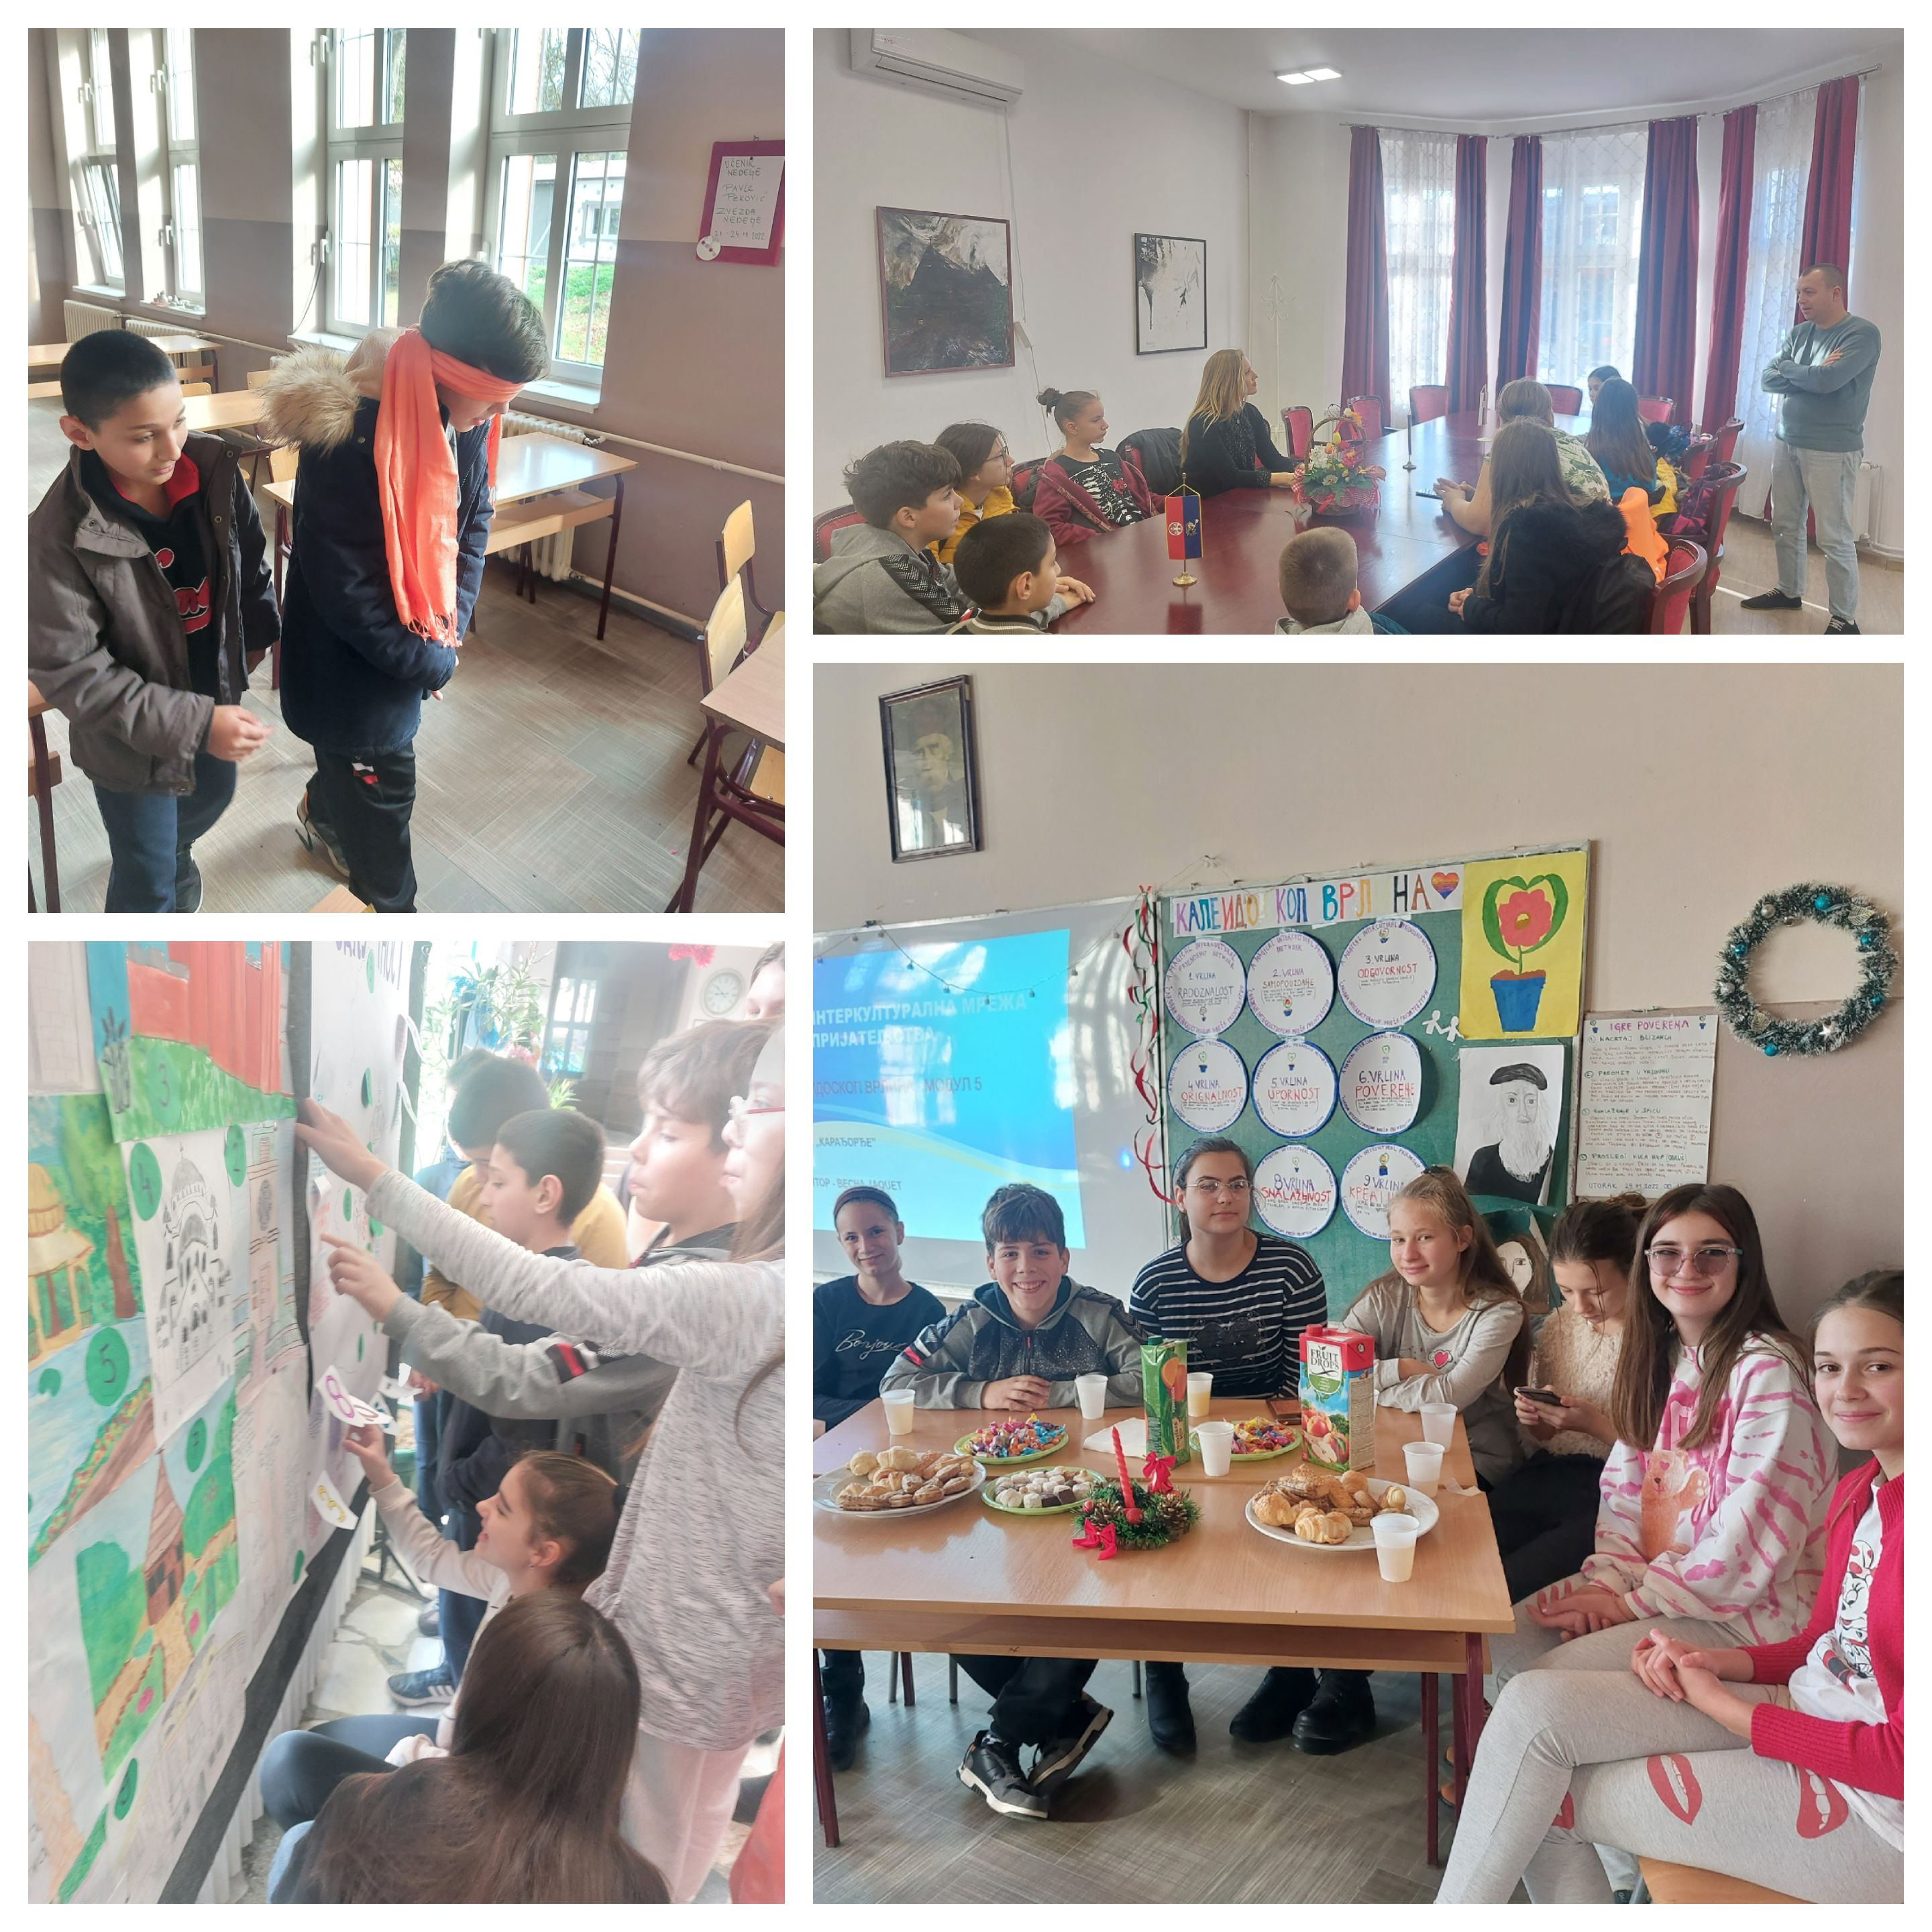
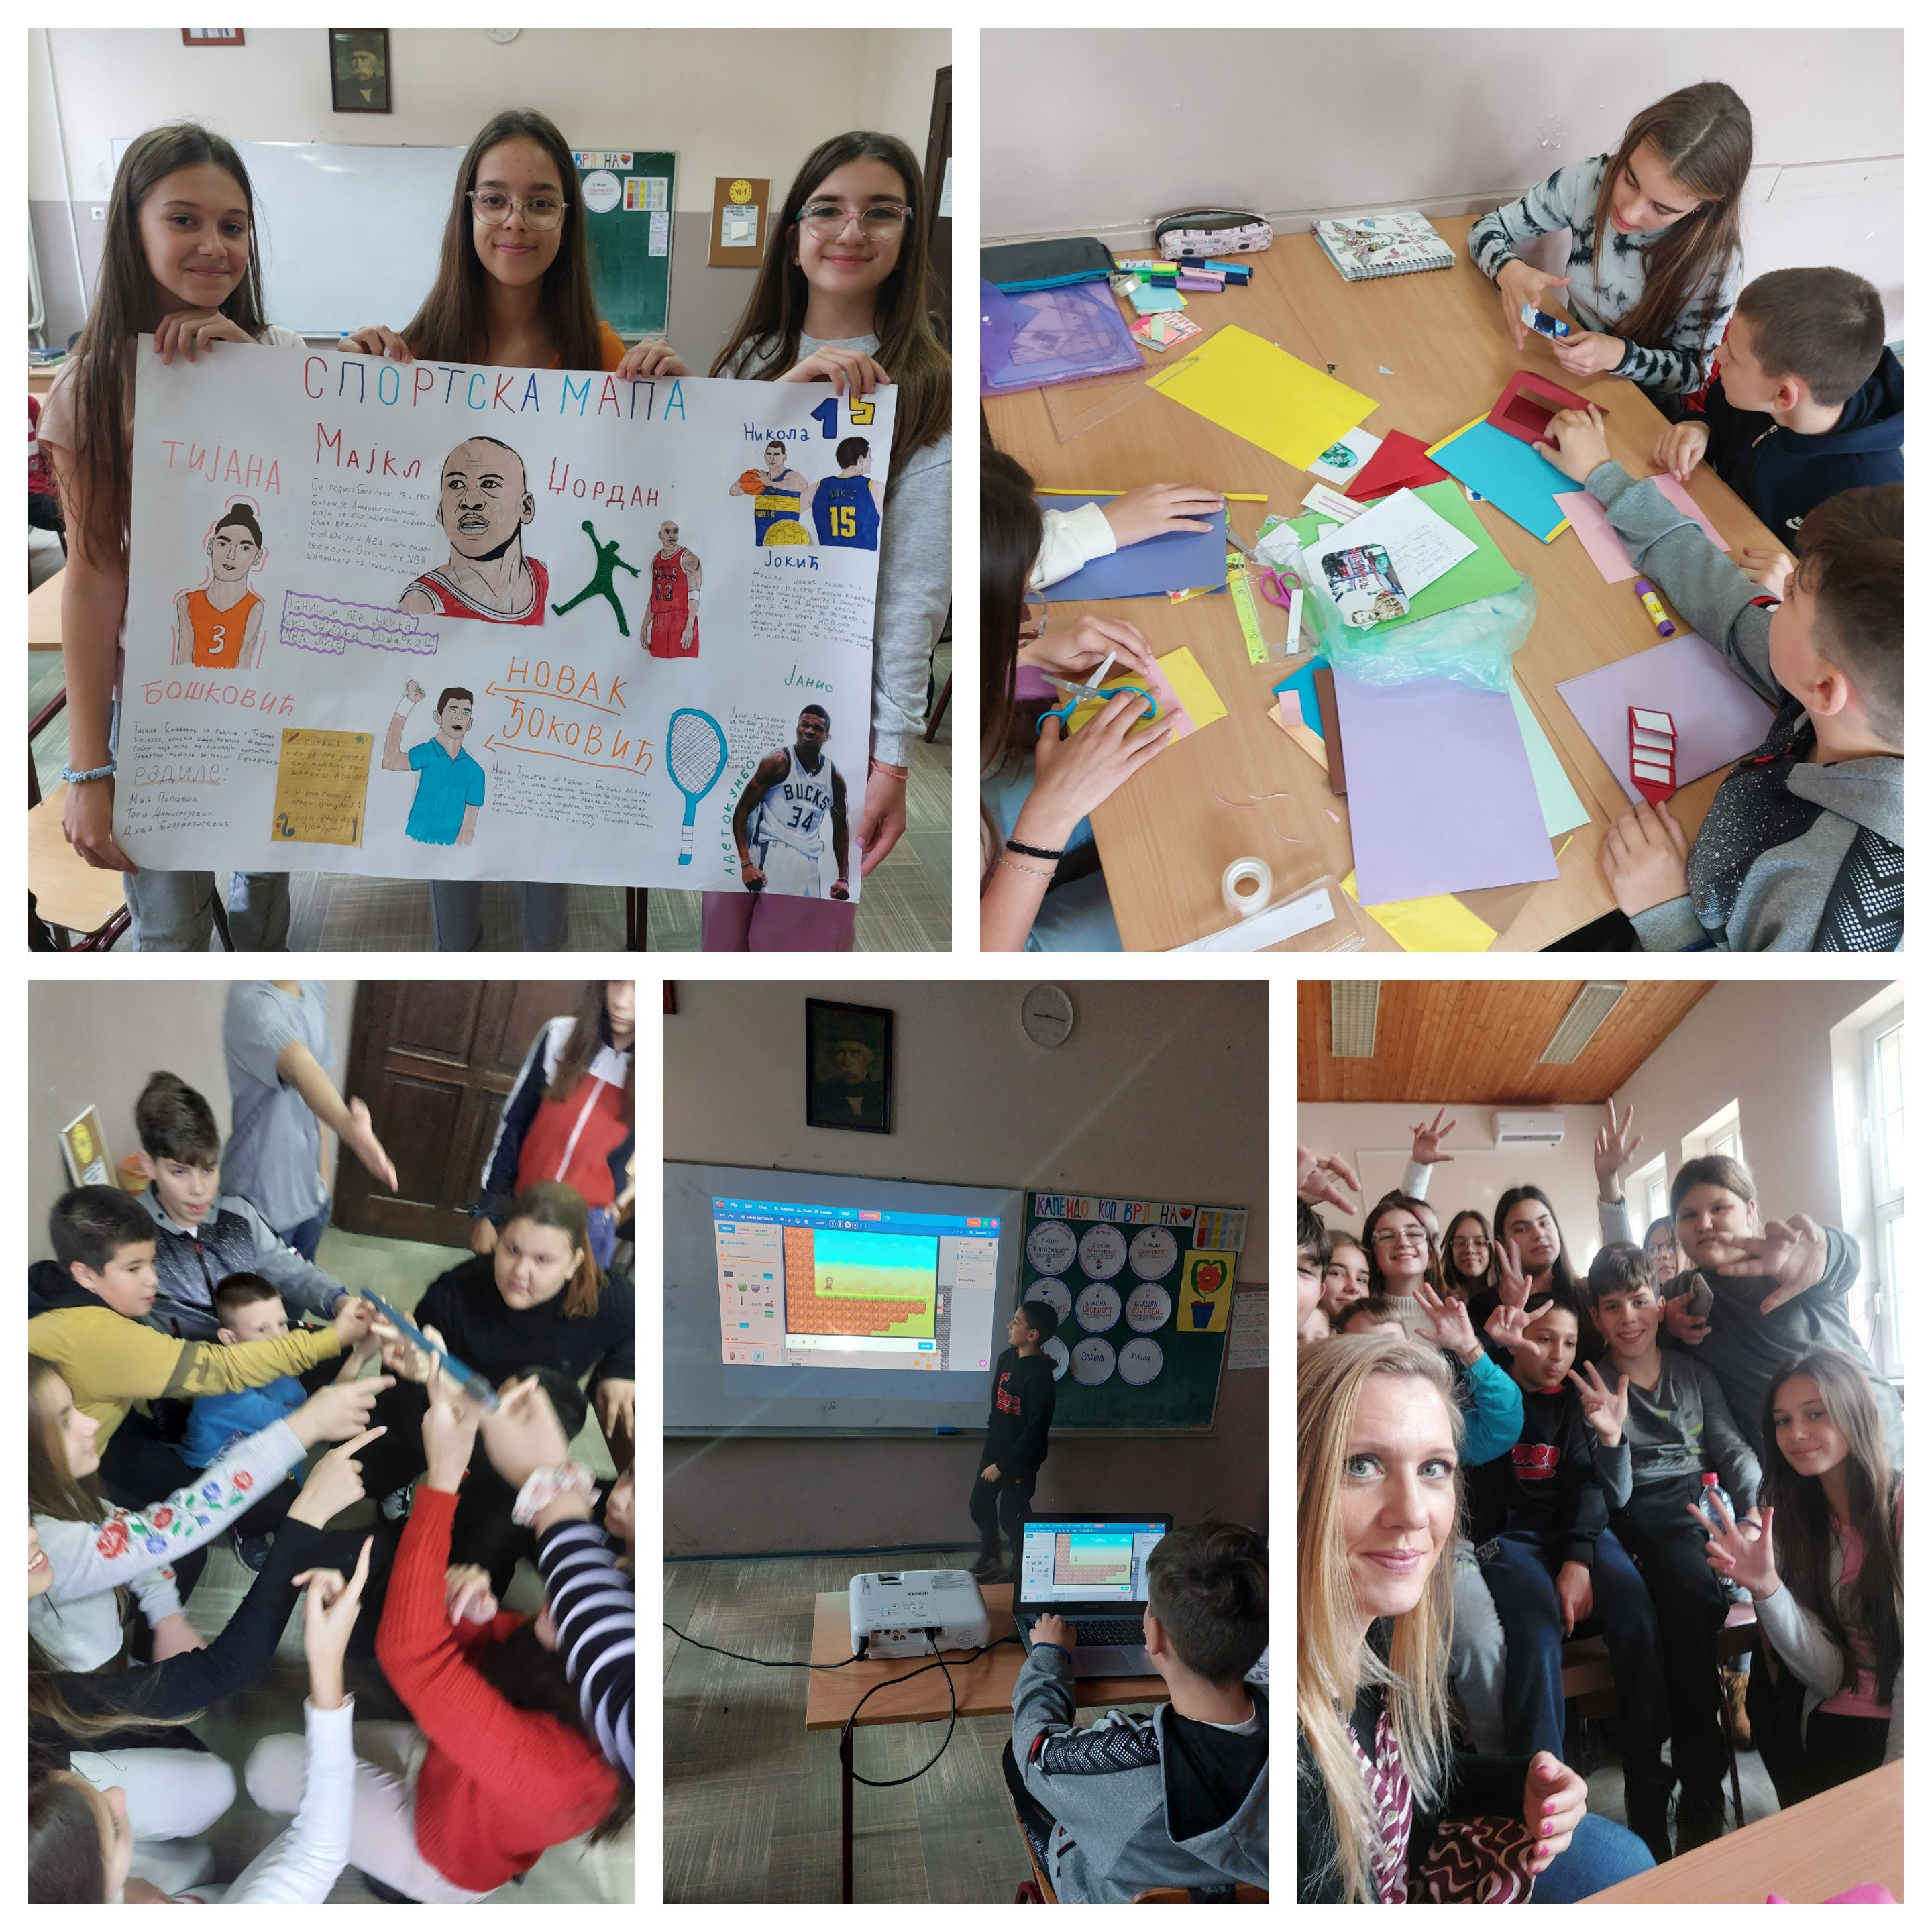
Respect - Tolerance - Be actively engaged

Slide 5
THANK YOU
France, Poitiers 2023
Vesna Jaquet, English language teacher
vesna.novicic@gmail.com

